Slide 1



Information Security awareness
St. Pölten University of Applied Sciences

Slide 2
Who we are?
Adrian Flita-Vasile
Adithyan Shyni Manoj
Alen Marian V V
Rakesh Vijayan
We are from IT Security department of St. Pölten University of Applied Sciences.

Slide 3
What is Cyber Security ?
The practice of defending internet-connected devices from cyber attacks.

Slide 4
Importance of Cyber security
The internet allows an attacker to work from anywhere on the planet.
Cybersecurity serves as the wall keeping bad actors from accessing sensitive data and taking down networks. Even a single successful cyberattack can cause irreparable damage.

Slide 5
The Target Group for this presentation is employees of St. Pölten University of Applied Sciences, Which INCLUDES: chairpersons of the university, academic staff members and students.

Slide 6
What are the challenges you are going to face?
Phishing Attacks
Social Engineering Attacks
Malware Attacks
Man in the Middle Attacks
Internal Attack
Notes:
Transferring money to the university account.

Slide 7
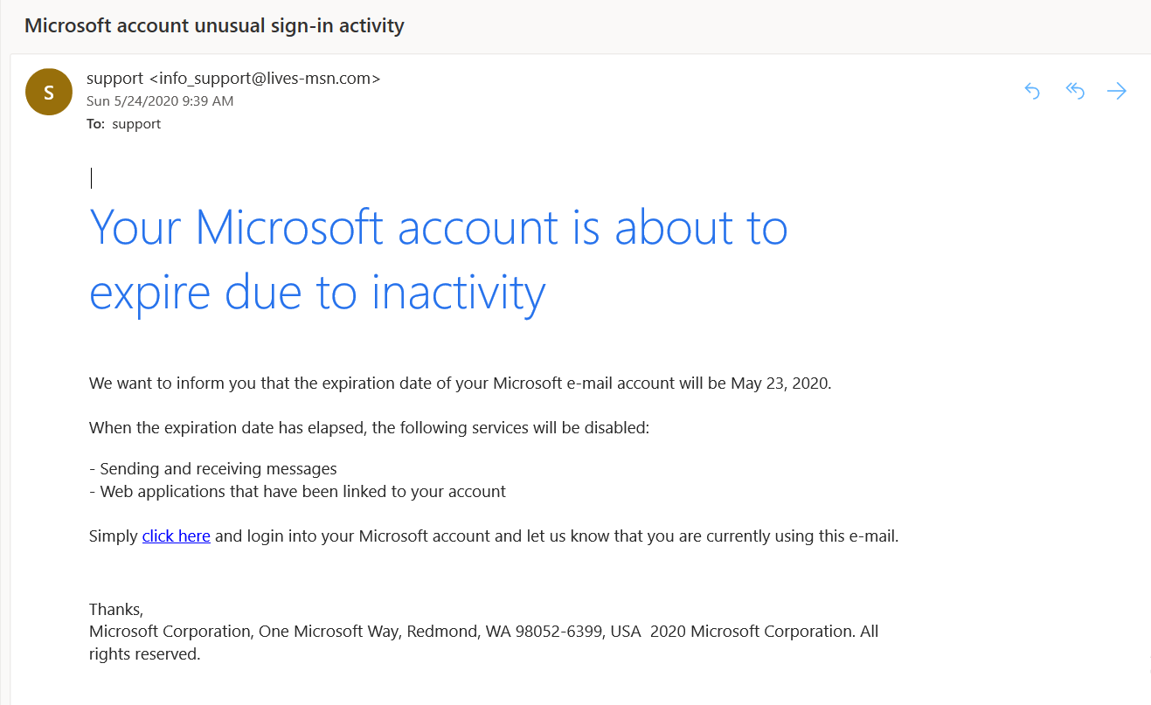
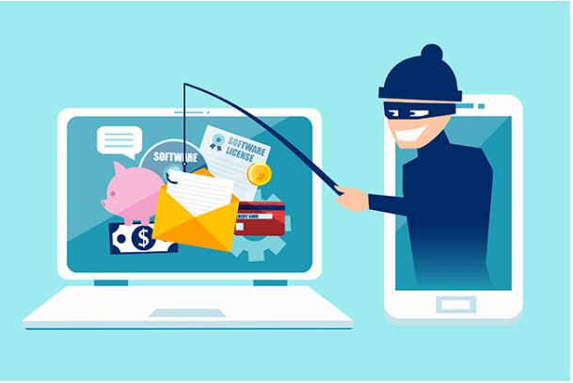
Aware about the phishing emails
Phishing: A seemingly trustworthy entity asks for sensitive information such as SSN(SOCIAL SECURITY NUMEBR), credit card numbers, login IDs or passwords via e-mail.

Slide 8


Social Engineering
Social engineering manipulates people into performing actions or divulging confidential information. Similar to a confidence trick or simple fraud, the term applies to the use of deception to gain information, commit fraud, or access computer systems.
Phone Call:
This is John, the System Administrator. What is your password?
Email:
ABC Bank has
noticed a
problem with
your account…
I have come to repair your machine…
and have some lovely software patches!

Slide 9
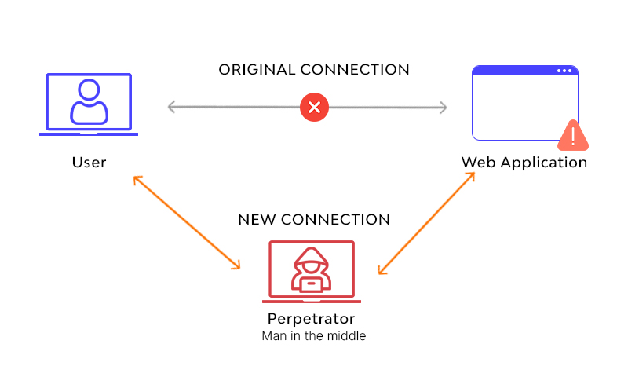
Man In The Middle Attack
An attacker pretends to be your final destination on the network. When a person tries to connect to a specific destination, an attacker can mislead him to a different service and pretend to be that network access point or server.

Slide 10
Malware Attacks
Malware is any kind of software that's designed to harm a computer. Malware can steal sensitive information from your computer, gradually slow down your computer, or even send fake emails from your email account without your knowledge. Additionally, these attacks compromise valuable data and can even shut down your systems for an extended period of time, making it very difficult to conduct normal operations.
How to avoid malware attacks:
Downloading free software from the Internet that secretly contains malware
Downloading legitimate software that's secretly bundled with malware
Visiting a website that's infected with malware
Clicking a fake error message or pop-up window that starts a malware download
Opening an email attachment that contains malware

Slide 11
Internal Attack
Careless insider—an innocent pawn who unknowingly exposes the system to outside threats. This is the most common type of insider threat, resulting from mistakes, such as leaving a device exposed or falling victim to a scam. For example, an employee who intends no harm may click on an insecure link, infecting the system with malware.
A mole—an imposter who is technically an outsider but has managed to gain insider access to a privileged network. This is someone from outside the organization who poses as an employee or partner.

Slide 12
Password security tips
never give out your password to anyone
don’t use one password
use a passphrase
make the password at least 10 characters long
include numbers, capital letters and symbols
consider using a password manager
consider using multi-factor authentication
don’t fall for phishing attacks
make sure your devices are secure
use a password or fingerprints for your phone too.

Slide 13
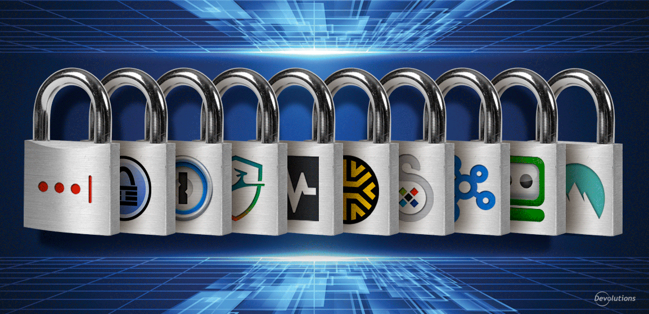
Password Manager
Password managers are apps that generate new, random passwords for all the sites you visit. They store these credentials for you in a secure virtual vault. Then, when you visit a site or open an app where you need to log in, the password manager automatically fills in your login name and password for you. Most password managers can also fill in your personal information, like name, address, and credit card number on web forms to save you time during account creation or checkout when making a purchase online. Some password managers can store your important documents or other credentials like safe codes and medical information in the vault, too.
The best password managers let you know if your existing passwords are weak, reused, or have shown up in a data breach. These products help you improve your password hygiene by suggesting new, strong, and unique credentials for every login. We recommend setting your password manager to generate passwords that are at least 20 characters long and include all the major character types: uppercase, lower case, numbers, and symbols.

Slide 14
STORY TIME !

